Slide 1

CME Basics
Educational Planning and Evaluation
Standards for Integrity and Independence in Accredited Continuing Education

Slide 2
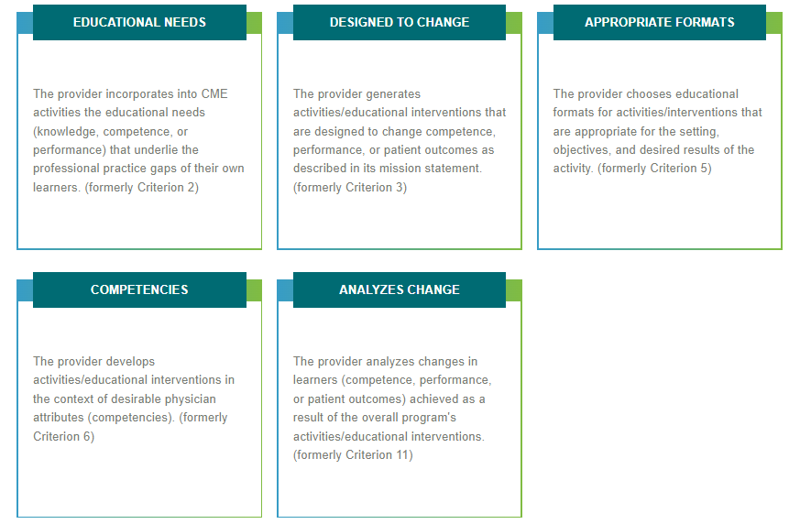
Educational Planning and Evaluation

Slide 3
Educational Needs
The provider incorporates into CME activities the educational needs (knowledge, competence, or performance) that underlie the professional practice gaps of their own learners. (formerly Criterion 2)
ACCME Note:
The accredited provider addresses, through its CME activities, problems in practice and/or patient care. As part of that effort, the provider examines those problems and looks for knowledge, strategy, skill, performance, or system deficits that could be contributing to the problems. By doing so, the provider is able to plan and implement education that will effectively address the problems.

Slide 4
Designed to Change
The provider generates activities/educational interventions that are designed to change competence, performance, or patient outcomes as described in its mission statement. (formerly Criterion 3)
ACCME Note
In fulfillment of its mission, and as a next step in the planning process, the accredited provider designs its education to change learners’ strategies/skills (i.e., competence), and/or what learners actually do in practice (i.e., performance), and/or the impact on the patient or on the care delivered (i.e., patient outcomes).

Slide 5
Appropriate Formats
The provider chooses educational formats for activities/interventions that are appropriate for the setting, objectives, and desired results of the activity. (formerly Criterion 5)
ACCME Note
All activity formats (e.g., didactic, small group, interactive, hands-on skills labs) are acceptable and should be chosen based on what the provider hopes to change as a result of the education. Adult education literature provides guidance about which learning formats are more effective than others depending on the outcome that is desired, the setting, and the needs of the learners.

Slide 6
Appropriate Formats, cont’d
The format should be conducive to measuring change, such as a learner demonstrating through a simulation that they understand the material. For changing knowledge and competence, a didactic lecture might be best. A didactic lecture split up into smaller groups may be a way to reinforce the education and allow the learner to hear the information in a different way which should ultimately add to a learner’s experience and create good evaluation data showing a measure of change. To reach more people at a given time, online formats might be best. Using multiple formats also reinforces the education. To be compliant, the planner needs to demonstrate that the format was considered as part of the planning process.

Slide 7
Competencies
The provider develops activities/educational interventions in the context of desirable physician attributes [e.g., Institute of Medicine (IOM) competencies, Accreditation Council for Graduate Medical Education (ACGME) Competencies]. (formerly Criterion 6)
ACCME Note
The ACCME is looking for an active recognition of “desirable physician attributes” in the planning process (e.g., “We have planned to do a set of activities that touch on professionalism and communications to address our patients’ concerns that they are not receiving complete discharge instructions – which is the identified professional practice gap.”) The simple labeling of an activity with a competency is a start and provides the learner with information with which to choose an activity and potentially will be important for reporting purposes within Maintenance of Certification/Continuing Certification.

Slide 8
Competencies, cont’d
This criterion is an integral part of the planning process. Starting from the mission, planners determine desired results, identify a gap and the need that underlies the gap, the format is chosen (Appropriate Formats) and then this criterion talks about content in terms of physician competencies. What is the content designed to change for the learners? Planners need to specify and make clear what competencies are to be met in the content of each activity.

Slide 9
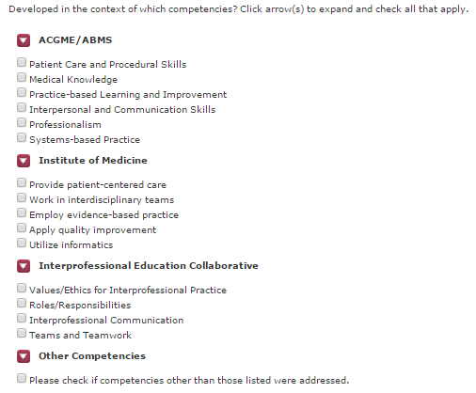
List of Competencies

Slide 10
Analyzes Change
The provider analyzes changes in learners (competence, performance, or patient outcomes) achieved as a result of the overall program's activities/educational interventions. (formerly Criterion 11)
ACCME Note
The accredited provider is asked to collect data and information about the changes that result from its educational interventions, including changes it expects learners to make, changes that learners actually make, and/or the impact on patients. Using this data and information, the provider is asked to look across all its activities and analyze its impact in terms of those changes.

Slide 11
ACCME Compliance Check: Analyzing Learner Change
How do you know if your CME is effective? How do you measure success? Whether you’re new to ACCME accreditation or have years’ experience as an accredited provider, you’ll want to analyze the changes your CME learners are making. ACCME’s Analyzes Change criterion requires that: “The provider analyzes change in learners (competence, performance, or patient outcomes) achieved as a result of the overall program’s activities/educational interventions.” The word “competence” mentioned in the criterion does not refer simply to an increase in learner knowledge. Competence can be thought of as the strategy to do something—to put knowledge into action, as well as what the learner will do in practice, if given the opportunity. The Analyzes Change criterion requires that: The learner needs to be able to put into practice the knowledge they have gained. You, as the provider, need to have data on what changes have occurred in the learner's ability, practice, or patient outcomes. Asking your learner to provide examples of changes they made or plan to make will help you get the data you need to measure learner change and the effectiveness of your program. You will want to know the specific things learners change or plan to change so you can analyze those changes against your activity goals and program mission. ACCME’s Analyzes Change criterion provides a great opportunity to see where you’ve succeeded and where you might need to make improvements. To learn more, ACCME encourages you to visit the ACCME Academy’s short online video Analyzes Change, Program Analysis, & Program Improvement. On the ACCME website, you’ll also find examples of Compliance & Noncompliance specific to the Analyzes Change criterion.

Slide 12
Standards for Integrity and Independence in Accredited Continuing Education

Slide 13
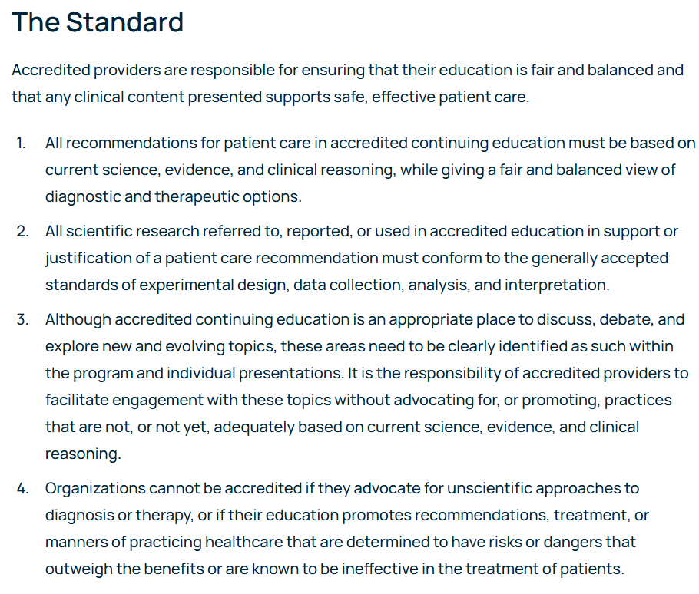
Standard 1: Ensure Content is Valid

Slide 14
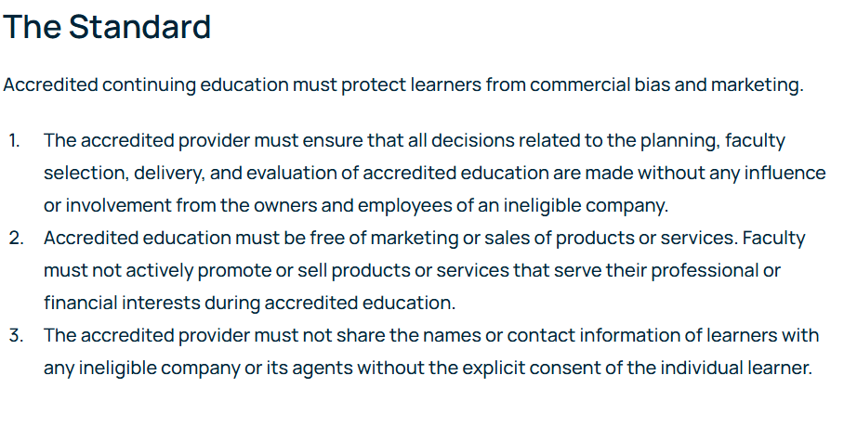
Standard 2: Prevent Commercial Bias and Marketing in Accredited Continuing Education

Slide 15

Standard 3: Identify, Mitigate, and Disclose Relevant Financial Relationships

Slide 16
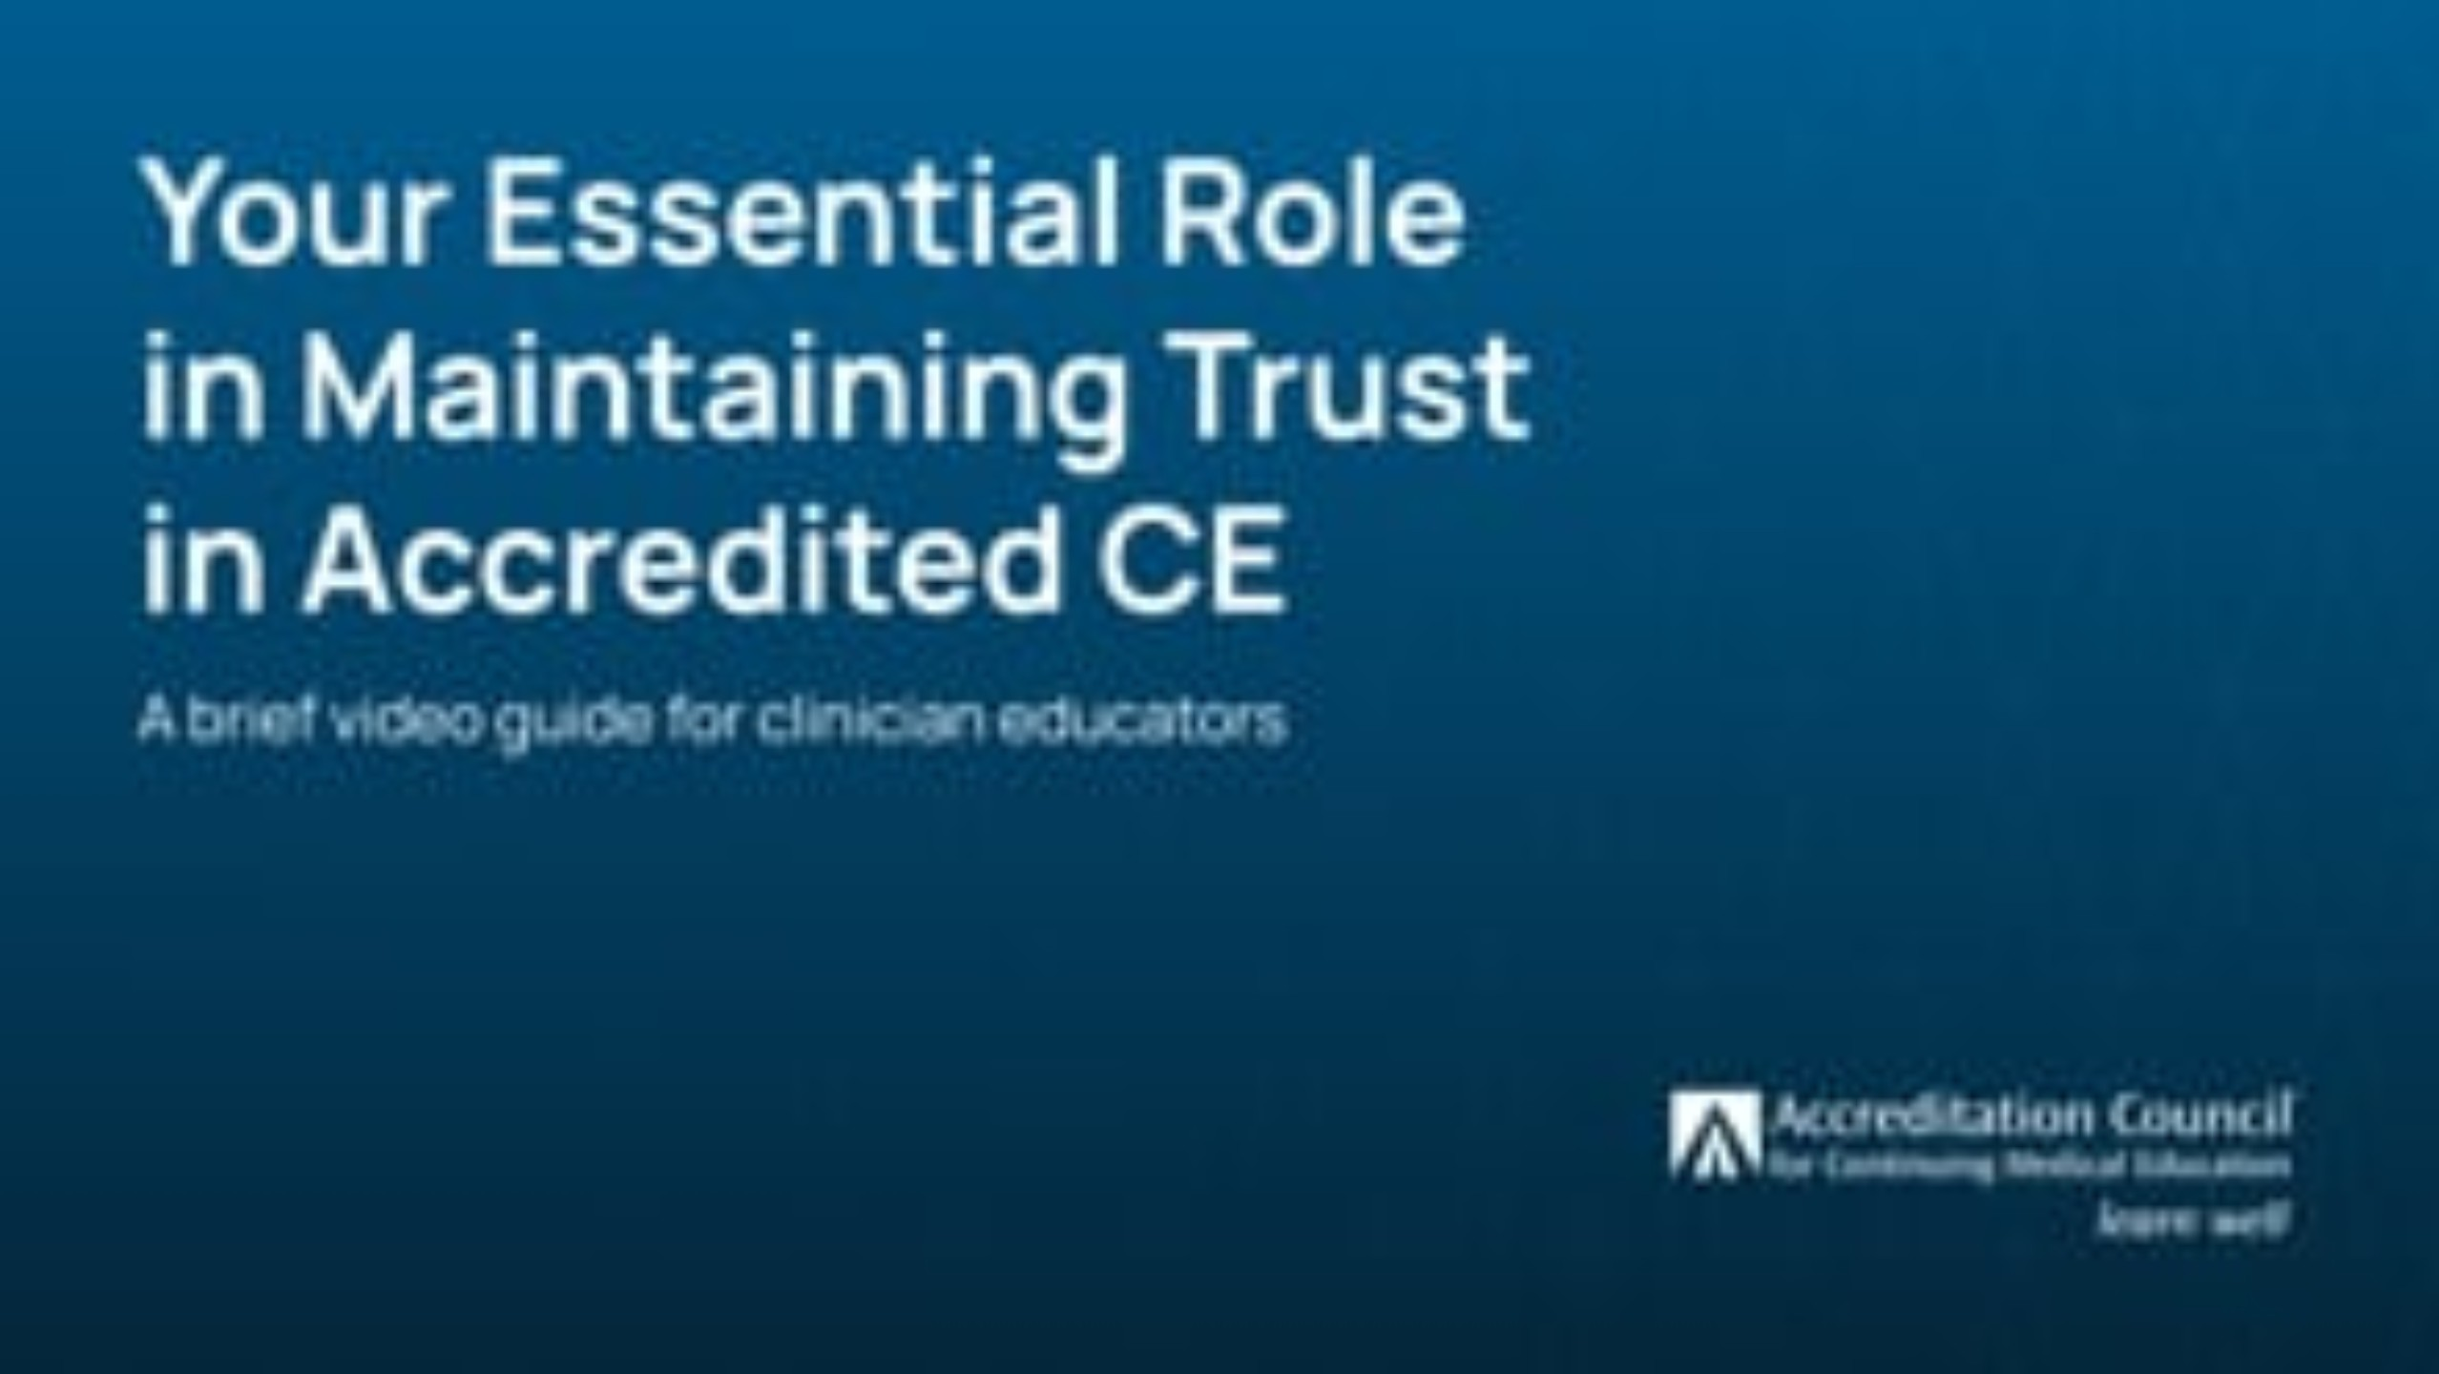
Video: “Your Essential Role in Maintaining Trust in Accredited CE”

Slide 17








What Is The Process To Ensure Independence From Commercial Influence In Accredited Continuing Education?
Collect information about financial relationships
We ask those who may have a role in controlling the CE content to disclose all financial relationships they have had over the past 24 months with ineligible companies
(drug, device, and other companies ineligible for accreditation; see page 2 for the full definition).
Exclude owners or employees of ineligible companies
With a few exceptions, we exclude owners or employees of ineligible companies because their opportunity to insert commercial bias cannot be mitigated.
Identify and mitigate relevant financial relationships
We determine which financial relationships might allow control of CE content related to the business lines or products of an ineligible company and take steps to prevent the insertion of bias towards commercial products or services.
Disclose all relevant financial relationships to learners
We provide transparency to learners by informing them—prior to the CE activity—of the presence or absence of relevant financial relationships for all who were in control of the CE content, and that those relevant financial relationships were mitigated.
Planning Guide for Independence in Accredited Continuing Education
© 2021 Accreditation Council for Continuing Medical Education (ACCME®)

Slide 18
There are educational situations that allow you to skip these steps...
Accredited CE providers do not need to identify, mitigate, or disclose relevant financial relationships for education that meets one or more of these exceptions.
Will the accredited education be non-clinical, such as leadership or communication skills training?
Will a learner group be solely in control of content of the accredited education, such as a spontaneous case conversation among peers?
Will this be self-directed education where the learner controls their educational goals and reports on changes that resulted, such as learning from teaching, remediation, or a personal development plan?
Explore these opportunities with your CE staff.
Planning Guide for Independence in Accredited Continuing Education
© 2021 Accreditation Council for Continuing Medical Education (ACCME®)

Slide 19




How Do I Participate In The Planning and Presentation of Accredited Continuing Education?
Who needs to disclose?
If you play any of these roles in accredited continuing education, you need to disclose financial relationships.
Planners
Faculty/Teachers
Authors
Reviewers
Examples: Planning committees,
CE staff, editors,
activity directors
Examples: Speakers, panelists, instructors, trainers, coaches, educational consultants
Examples: Writers, editors, instructional designers, content developers, educational researchers, CE staff
Examples: Peer reviewers, editors, CE staff
Planning Guide for Independence in Accredited Continuing Education
© 2021 Accreditation Council for Continuing Medical Education (ACCME®)

Slide 20
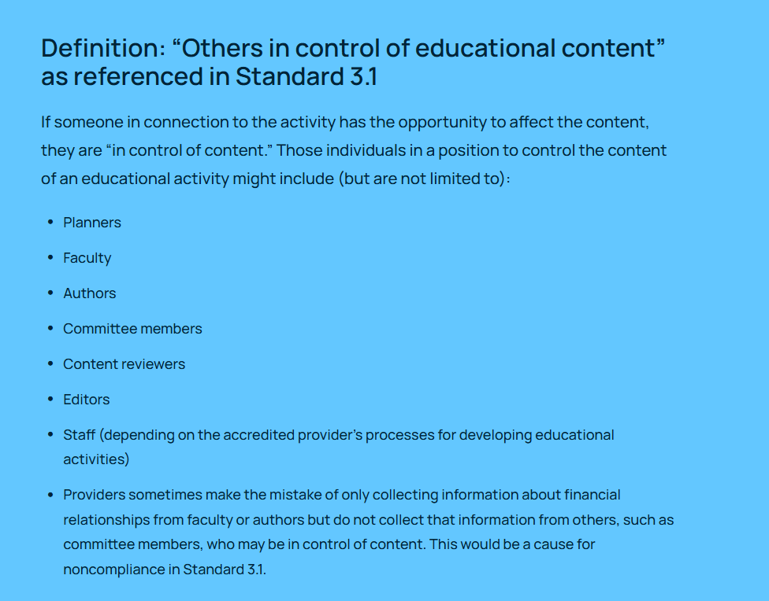

Slide 21
How Do I Participate In The Planning and Presentation of Accredited Continuing Education?
What needs to be disclosed?
You must disclose all your financial relationships over the past 24 months with ineligible companies on this list.
Disclose relationships whether or not they have already ended during the past 24 months.
Advertising, marketing, or communication firms
whose clients are ineligible companies
Bio-medical startups
that have begun a governmental regulatory approval process
Compounding pharmacies
that manufacture proprietary compounds
Device manufacturers or distributors
Diagnostic labs
that sell proprietary products
Growers, distributors, manufacturers or sellers of medical foods and dietary supplements
Manufacturers of health-related wearable products
Pharmaceutical companies or distributors
Pharmacy benefit managers
Reagent manufacturers or sellers
These are companies whose primary business is producing, marketing, selling, re-selling, or distributing healthcare products used by or on patients.
They are ineligible to be accredited in the ACCME System.
Planning Guide for Independence in Accredited Continuing Education
© 2021 Accreditation Council for Continuing Medical Education (ACCME®)

Slide 22
How Do I Participate In The Planning and Presentation of Accredited Continuing Education?
What needs to be disclosed?
There is no minimal threshold or amount and the financial relationships you disclose should include any of these roles.
Owner
(e.g., sole proprietor, stockholder in privately-held company)
Employee
Executive role
Researcher
Consultant, Advisor, Speaker
Independent Contractor
(including contracted research)
Royalties or patent beneficiary
Individual publicly traded stocks and stock options
Diversified mutual funds do not need to be disclosed.
Research funding from ineligible companies should be disclosed by the principal or named investigator even if that individual’s institution receives the research grant and manages the funds.
Planning Guide for Independence in Accredited Continuing Education
© 2021 Accreditation Council for Continuing Medical Education (ACCME®)

Slide 23
How Do We Identify and Mitigate Relevant Financial Relationships?
Consider everyone who can control content
Review financial relationship disclosures before those who can control content of accredited continuing education (CE) assume their roles.
Planners
Faculty/Teachers
Authors
Reviewers
Examples: Planning committees,
CE staff, editors,
activity directors
Examples: Speakers, panelists, instructors, trainers, coaches, educational consultants
Examples: Writers, editors, instructional designers, content developers, educational researchers, CE staff
Examples: Peer reviewers, editors, CE staff
Planning Guide for Independence in Accredited Continuing Education
© 2021 Accreditation Council for Continuing Medical Education (ACCME®)

Slide 24



How Do We Identify and Mitigate Relevant Financial Relationships?
Exclude owners and employees
First, we must exclude owners and employees of ineligible companies from controlling content or participating as planners or faculty in accredited CE.
Owners
Employees
Owners and employees of ineligible companies have a legal duty to act in their company’s best interests. They are considered to have unresolvable financial relationships and must not be allowed to influence or control planning, delivery, or evaluation of accredited CE.
Planning Guide for Independence in Accredited Continuing Education
© 2021 Accreditation Council for Continuing Medical Education (ACCME®)

Slide 25



How Do We Identify and Mitigate Relevant Financial Relationships?
Exclude owners and employees
There are three exceptions when owners and employees of ineligible companies can participate as planners or faculty in accredited CE.
Content of the CE is not related to the business lines or products of their employer /company
Content of the CE is limited to basic science research (e.g., pre-clinical research and drug discovery), methodologies of research, no care recommendations are given
Participating as technicians to teach the safe and proper use of medical devices, do not recommend whether or when a device is used
Planning Guide for Independence in Accredited Continuing Education
© 2021 Accreditation Council for Continuing Medical Education (ACCME®)
934_20211028
Page 10 of 13

Slide 26

How Do We Identify and Mitigate Relevant Financial Relationships?
Is the financial relationship related to the content?
Determine if the educational content the person can control is related to the business lines or products of the ineligible company with whom they have a financial relationship.
Would the person’s role in the CE activity allow them to insert commercial bias into the content?
Is the content of the CE activity that the person can control related to the products or business lines of the ineligible company?
Planning Guide for Independence in Accredited Continuing Education
© 2021 Accreditation Council for Continuing Medical Education (ACCME®)

Slide 27
How Do We Identify and Mitigate Relevant Financial Relationships?
Mitigate relevant financial relationships
Determine if the educational content the person can control is related to the business lines or products of the ineligible company with whom they have a financial relationship.
Planners, reviewers
End the financial relationship
(including having ended the relationship within 24 months).
Recuse individual from controlling aspects of planning and content with which there is a financial relationship.
Peer review planning decisions and review determinations by persons without relevant financial relationships.
Making decisions related to the scope and direction of the content, educational goals, identification of practice gaps and needs, selecting speakers, authors, and reviewers
Faculty/
teachers, authors
End the financial relationship
(including having ended the relationship within 24 months).
Recuse individual from controlling aspects of planning and content with which there is a financial relationship.
Peer review of content by persons without relevant financial relationships.
Attest that clinical recommendations are evidence-based and free of commercial bias (e.g., peer-reviewed literature, adhering to evidence-based practice guidelines).
Teaching, writing, producing and delivering education
Planning Guide for Independence in Accredited Continuing Education
© 2021 Accreditation Council for Continuing Medical Education (ACCME®)

Slide 28
How Do We Identify and Mitigate Relevant Financial Relationships?
Disclose to learners
Before learners engage in the accredited CE, disclose all relevant financial relationships to learners.
Disclosure to learners includes:
The names of the individuals with relevant financial relationships.
The names of the ineligible companies with which they have relationships.
The nature of the relationships.
A statement that all relevant financial relationships have been mitigated.
The absence of relevant financial relationships (if applicable).
Planning Guide for Independence in Accredited Continuing Education
© 2021 Accreditation Council for Continuing Medical Education (ACCME®)

Slide 29
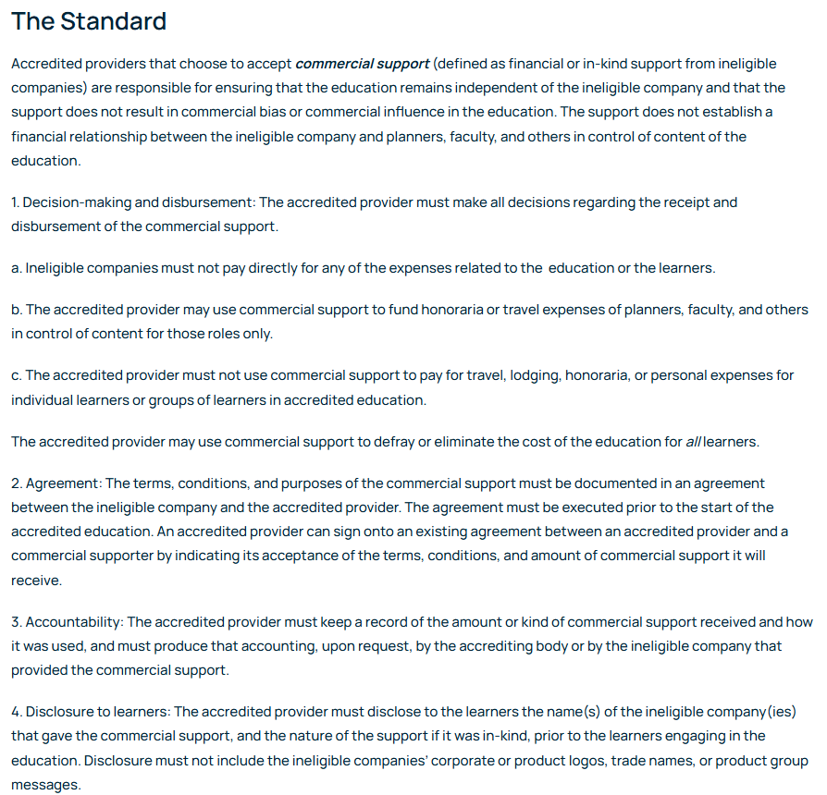
Standard 4: Manage Commercial Support Appropriately

Slide 30
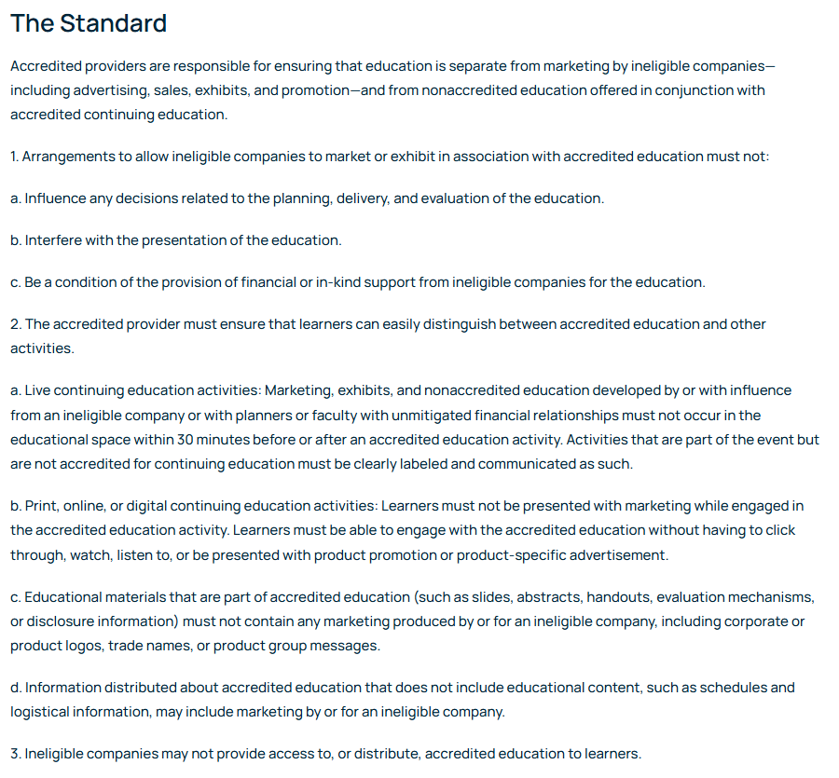
Standard 5: Manage Ancillary Activities Offered in Conjunction with Accredited Continuing Education

Slide 31
MSSNY EXPECTATIONS
CME Program Coordinators

Slide 32

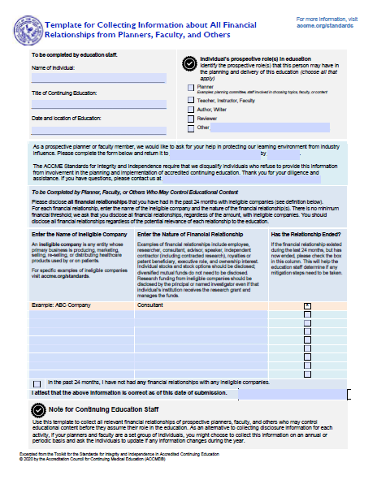
Application
Submitted by second Wednesday of the month the application is to be considered
Completed application addressing the planning and evaluation criteria and Standards for Integrity and Independence in Accredited CE
Completed Financial Disclosure Forms from individuals in control of content

Slide 33
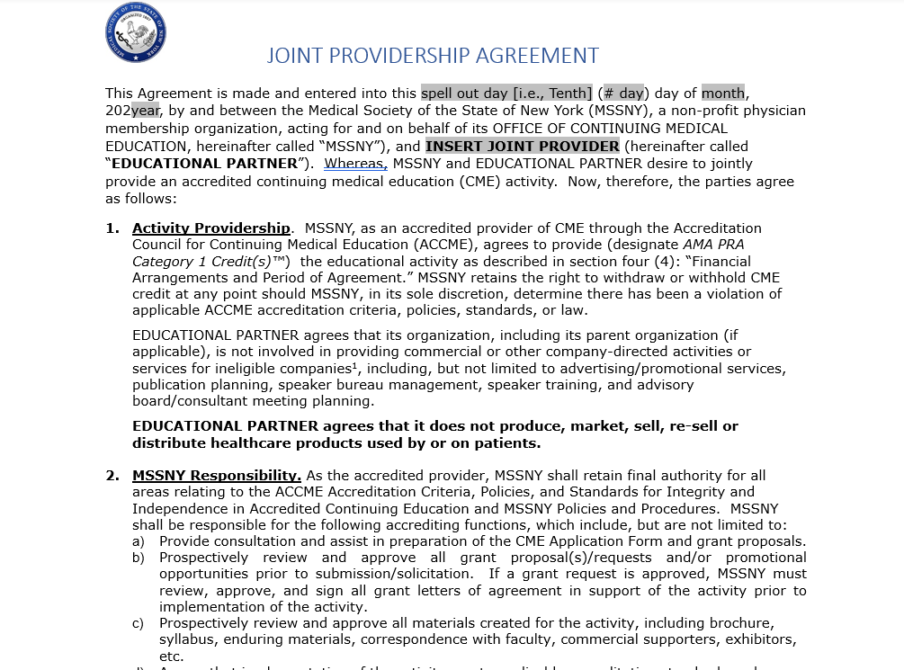
Joint Providership Agreement
We require that all joint providers complete and sign MSSNY’s Joint Providership Agreement.

Slide 34
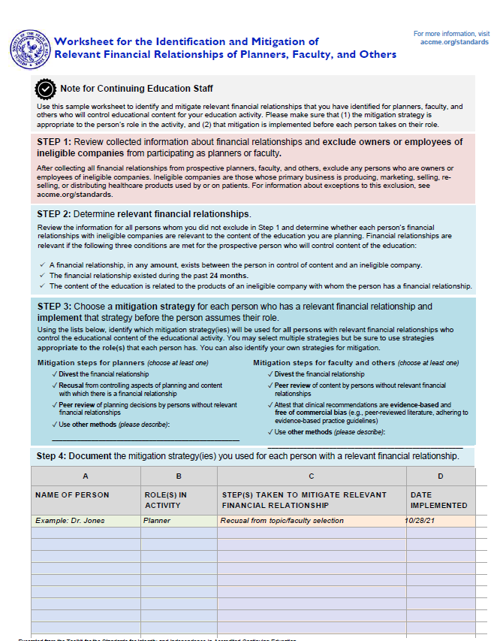
This worksheet should be used to keep track of the mitigation strategies used for any individuals who have disclosed a financial relationship that has been identified as relevant.
Note that Step 3 demonstrates mitigation steps appropriate for planners and steps appropriate for faculty.

Slide 35
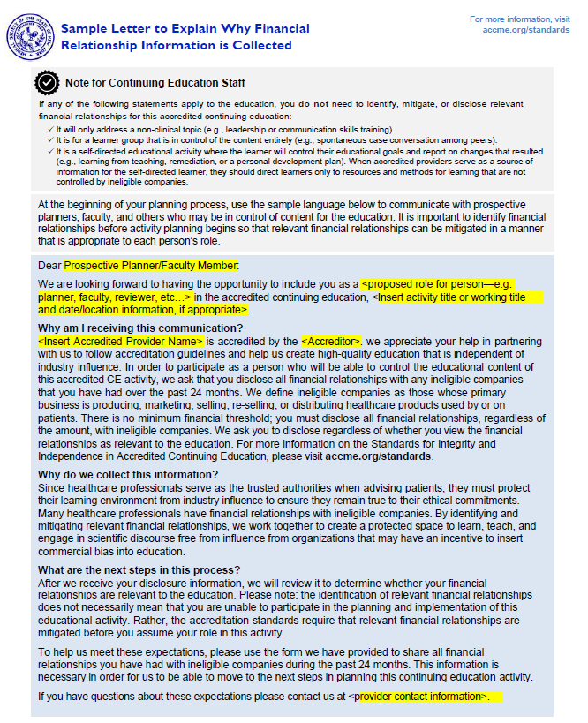
Letter that can be used for prospective planners and faculty members
Explains the need for collecting information on financial relationships with ineligible companies
May be particularly useful for individuals new to serving in a CME role.

Slide 36
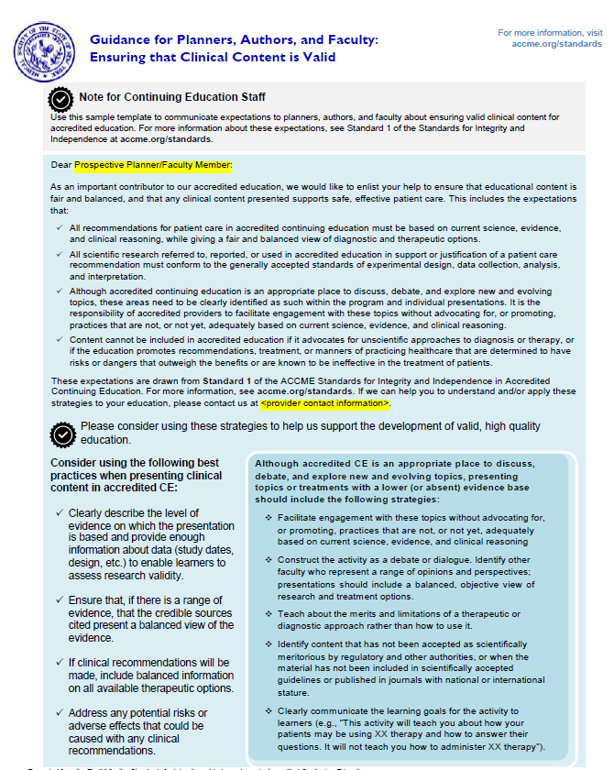
Letter on clinical content validity, for planners, authors, and faculty.
It would be advisable to use this letter for any individuals in the above-listed roles, for CME with clinical content.
Although formerly, much of the emphasis on ensuring content was valid was coupled with RFRs and ensuring the content was free of commercial bias, ACCME’s content validity requirements go beyond that issue.

Slide 37
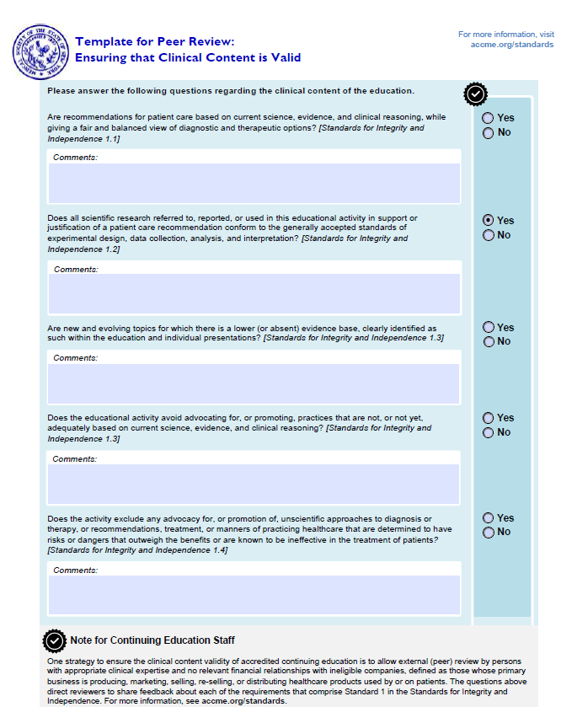
This form should be used for all CME activities with clinical content.
Should be used regardless of RFR status.
Peer reviewer should have no relevant financial relationships.
Peer reviewer must complete financial-relationship form.
Include “reviewers” in disclosures.
(“Reviewer has no relevant financial relationships.”)

Slide 38
Post-Activity

Slide 39
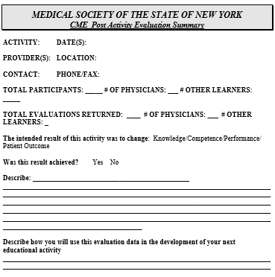
To be Submitted to MSSNY after Activity
Attendance figures, divided into physicians (MD and DO) and other learners;
Complete attendance records, including first name, last name, professional credentials (MD or DO for physicians), and email address (Excel spreadsheet preferred);
Summarized evaluation data and analysis on the degree to which the activity was successful in enacting the learner change it was designed for.

Slide 40

Questions?

