Slide 1
Strategic Planning update
BOT + Council (March 2024)
Troy Oechsner
MSSNY EVP

Slide 2
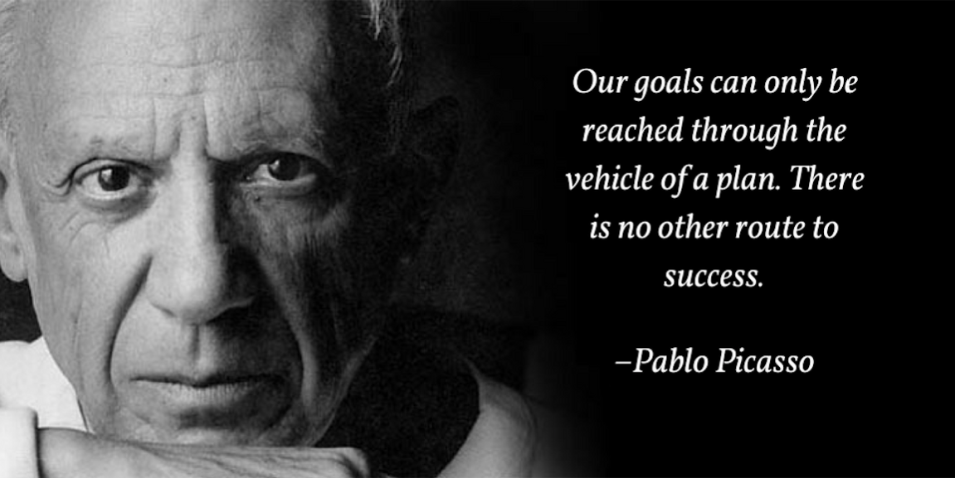
Your best quote that reflects your approach… “It’s one small step for man, one giant leap for mankind.”
- Neil Armstrong

Slide 3
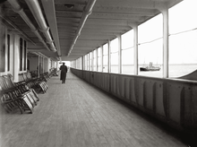
Stop Rearranging the deck chairs on the titanic
“Insanity is doing the same thing over and over and expecting a different result” Albert Einstein.

Slide 4
Prior Planning Exercises
2010
Robust. Outside firm. Extensive look at healthcare landscape
Focus on substantive issues. Familiar: e.g., insurance hassles, med mal, collective negotiation.
Organization: Also familiar: “adopt innovative membership strategies”, non-dues revenue.
Follow-Up. No clear evidence of consistent efforts.

Slide 5
Prior Planning Exercises
2018
Outline. In-house.
Areas: Membership, CME, Operations (staff, real estate, regionalization), HOD Modernization, Advocacy.
Familiar Focus: increase membership with communication and leadership development, non-dues revenue, physician well-being, collective negotiation (explore union affiliation), med mal.
Follow-Up. No clear evidence of consistent efforts.

Slide 6
2023 Strategic Planning Process
Kick-off meeting (January 31)
Blue-Sky suggestions (early February)
Member Needs Survey meeting (Feb 15)
Further Objectives (early March)
In-person weekend meeting (March 11-12)
Fine tuning by participants (April – May)
Adopted by Council (July)

Slide 7
Which areas did we address?
•Membership
Non-Dues Revenue
Governance
Communications
Advocacy

Slide 8
Group Work Process -- SMARTIE
S = Specific
M = Measurable
A = Achievable
R = Realistic
T = Timely
IE = Inclusive and Equitable

Slide 9
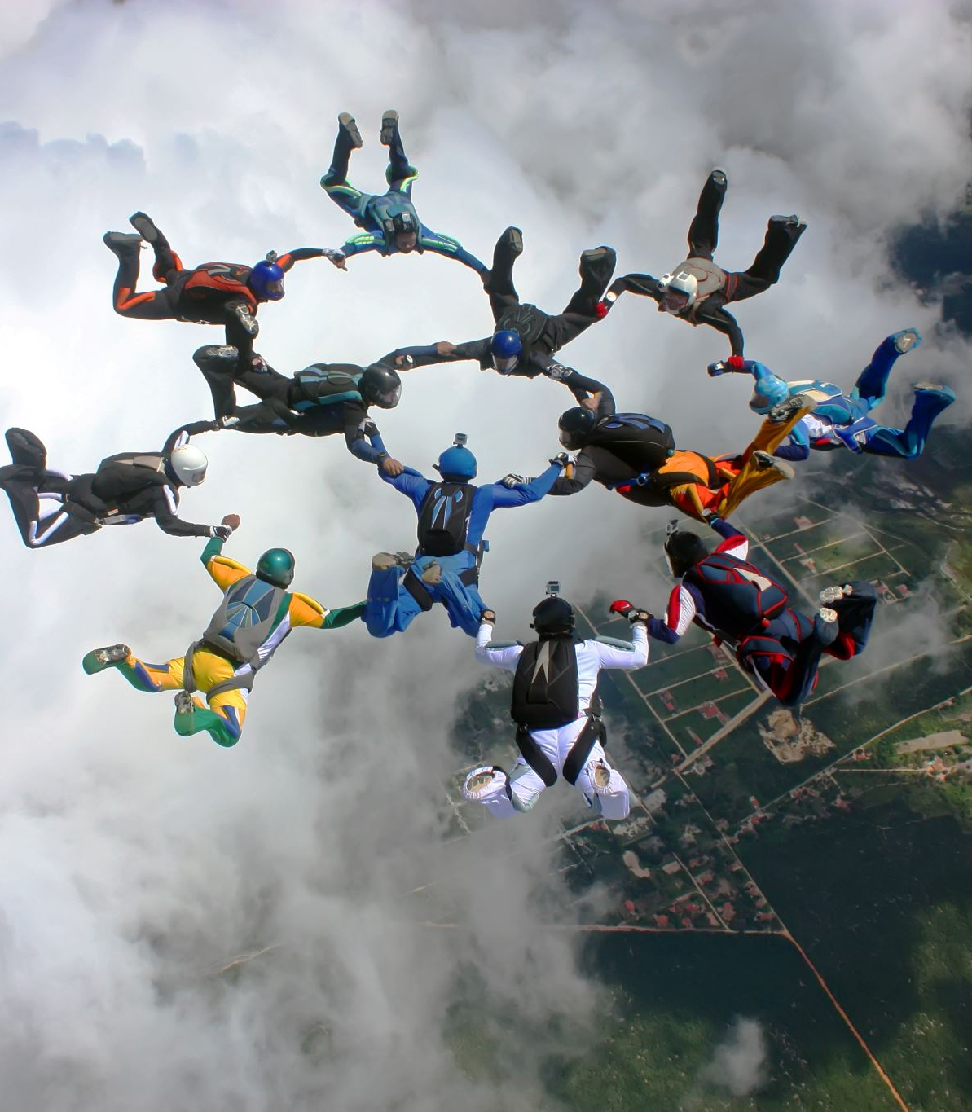
Group Work Plans
Objectives
Goals + Metrics
Tactics
Teams
Next Steps

Slide 10
Aspirational, Partnership
All goals, tactics and especially completion target dates are ASPIRATIONAL.
As Stategic Plan notes: Staff cannot do this alone. Physician leadership needs to partner and lead.

Slide 11
Objective: Membership
Increase membership, dues revenue, and diversity by improving value and employing effective means to recruit, engage, and retain members.

Slide 12
Decades of Dues Revenue Decline
MEMBERSHIP CONUNDRUM
Notes:
Dr. Jakubowicz
The decline in membership means real dollars to MSSNY.
Here you can see where our revenue has ended up and why we find ourselves in such a budget crises.

Slide 13
Goal 1: Membership Plan with 2% Growth Target 2024-2029
Staff review current draft, make edits (2023 YE)
Present revised draft to leadership (Q1 2024)
Execute (begin Q2 2024)

Slide 14
Current Individual Member Recruitment
Emphasis on young physicians
Focus group: benefits, communication
Outreach campaign
Working with student & resident leaders to recruit
Develop targeted marketing materials
Market poster symposium/events/committees as leadership opportunities
Re-up campaign for terminated group members
Lapsed member campaigns
Recruiting CME non-member participants
Building member personas for personal outreach
Developing a member referral campaign
Annual FOIL request:
Compare current database, ID new members
Outreach to recruit non-members
Streamlining application process
Creating a messaging calendar
Notes:
Valerie
I’d like to update you on our membership recruitment efforts starting with the individual categories of membership.
Go through slide.

Slide 15
Individual Membership
Done:
Filled Membership Development Specialist position
Streamlined structure from 29 to 8 categories.
Conducted Member Needs Survey
Created Newsletters: Pulse, Insider, Insider Buzz & Benefits in a Minute
Eliminated unused benefits
Added valuable benefits
Migrated to new database
Invited physicians formerly paid for by orgs to join as individuals
In Progress:
Simplifying application process
Updating & automating welcome campaign
Email marketing analysis
Updating collateral & member info pieces
Collaborating with counties on retention strategies
Membership campaigns
Researching ambassador programs
Membership & Marketing Plans for 2024 retention and renewals
​
Notes:
Valerie
I’d like to give you an idea of some of the things we’ve accomplished and others that are still in progress.

Slide 16
Current Organizational Membership
Done:
Streamlined Dues
16 counties yes
8 counties no
1 county N/A
35 counties no response
Six-week summer series with counties on recruiting orgs
In Progress:
Automating enrolment process
MOU -> Application
Updating membership brochure
Researching Ambassador program
Expanding contact lists
Identifying recognition programs
Collaborating with counties on retention
Increasing direct communication with org leaders
​
Notes:
Valerie
The membership committee submitted a proposal to streamline and make dues consistent for organizations. Both the board and the council approved it and 16 counties agreed to work within that terms.
There are still 35 counties that we haven’t heard from despite continual follow-up. This is indicative of a much bigger problem that we are not going to discuss today.
Walk through slide.

Slide 17
Goal 2: Enhance MSSNY/CMS Collaboration
MSSNY/CMS work together on proposal: (by Q2 2024)
MSSNY = Transparent admin/financial support + expertise, materials, training for CMSs
CMSs = Focus on recruitment, engagement, retention of physician leaders.
Survey other SMSs (by Q2 2024)
Needs assessment of CMSs (by Q3 2024)
Bring to leadership
Implement in Stages

Slide 18
What can you do?
Be welcoming!
Commit to calling new members.
Each recruit 5 new members in 2024.
Adopt a current group in your area. Get MSSNY on staff agendas regularly (see Troy/Valerie).
Recruit younger members then mentor them. Take interest.
If you identify benefits younger physicians need and want, inform staff.
Recruit colleagues who are the same age (or older) as well.
Notes:
Dr. Jakubowicz
So, what can you do? Go through bullets.
The Young physicians who participated in a recent focus group said they never felt welcomed and they always felt like an outsider at both county meetings and MSSNY’s HOD. We’re lucky they stayed since that was their first impression of MSSNY. Be welcoming!
Chemung County has been without physician leadership for years. Shirley and Brenda worked hard and Dr. Akula agreed to be president. I’m sure he would love to speak to some of you who have been president of your own county.
We are surrounded by colleagues. Recruit 5 members in 2024. If we each did that, how much better would MSSNY be doing?
Have you brought a colleague to a local county meeting?
We have to be intentionally inclusive, or we’re sunk.

Slide 19
What Can You Do? Be a Liaison
Current Institutional Members | District(s)
Bassett Healthcare | 6
Coalition of Asian-American IPA (CAIPA) | 1 & 2
LIJ/NSUH (Northwell Health) | 1 & 2
Long Island Community Hospital | 2
Northern Westchester Hospital | 9
NY Presbyterian Brooklyn Methodist | 1
Orleans Community Health | 8
St. Peters Health Partners Med. Assoc. | 3
Upstate Medical | 5
Notes:
Dr. Jakubowicz
At our last council meeting, we talked about our councilors being liaisons to our large groups and institutions.
We are requesting that you volunteer for one (or more) of these groups.
You can do that by sending me or Valerie the organization you choose.
We’d like to avoid making random assignments.

Slide 20
What Can You Do? Be a Liaison
CURRENT GROUP MEMBERS | DISTRICT(S)
Albany Gastro – Albany | 3
General Physicians PPC – Erie | 8
Hudson Headwaters Health Network (no discount) - Warren | 4
Integrated Medical Professions – Long Island | 1&2
New York Plastic Surgical Group – Nassau | 2
Ortho NY – Albany | 3
University of Buffalo Anesthesia Residents – Erie | 8
Windsong Group – Erie | 8
Zwanger Pesiri – Long Island | 1&2
ENT and Allergy Associates – Long Island, Hudson Valley | 1,2&9
Family Care Medical Group – Onondaga | 5
Healthcare Associates in Medicine – Richmond County | 1
New York Cancer and Blood Specialists – Long Island | 1&2
New York Cardiovascular Anesthesiologists (NYCA) – Nassau | 2
Schenectady Anesthesia Associates – Schenectady | 4
NSPC – Spine and Brain Surgery – Nassau | 2
Notes:
Dr. Jakubowicz
At our last council meeting, we talked about our councilors being liaisons to our large groups and institutions.
We are requesting that you volunteer for one (or more) of these groups.
You can do that by sending me or Valerie the organization you choose.
We’d like to avoid making random assignments.

Slide 21
MEMBERSHIP IS EVERYONE’S JOB
To include young physicians, we must be more collaborative and adaptable.
Millennials and Gen Z want to lead. We must create opportunities.
Every ask must have a purpose. Volunteers must have assignments.
To innovate, young physicians must be part of the process and heard.
Notes:
Dr. Jakubowicz
We are the leaders of this association. Both physicians and staff.
It is up to us to be ambassadors and lead by example.

Slide 22
Objective: Non-Dues Revenue
Goal: Increase non-dues revenue by 50% over five years and overall revenue by 20% without raising dues (by 2028 YE).
Non-Dues Revenue Committee (Dr. Lee, Chair)
* Proposal to monetize Physician Payment + Practice work (by 2023 YE)
* Find/promote short-term revenue-generating products/services w/CMSs (e.g. member benefits, education programs) (by Q2 2024).
* “Big-Hook” idea – Hackathon (2024)
* Admin services support to specialty societies, others

Slide 23
Objective: Governance
Improve the awareness, effectiveness, efficiency, inclusivity, and transparency of MSSNY governance.

Slide 24
Governance Goals + Tactics
Adopt MSSNY Code of Conduct (by 2024 HOD)
Survey SMSs via AAMSE
Establish clear, transparent leadership pathways
Create MSSNY Org Chart (by 2023 YE)
HOD Nominations Task Force recommendations (by 2024 HOD)
Establish mentorship program
ID best practices from other SMSs/assoc’s re: inclusivity, member growth, collaboration with CMSs/chapters (by 2024 YE).
Survey SMSs via AAMSE

Slide 25
Governance Goals + Tactics (cont).
Revise MSSNY Bylaws (2024 YE)
Survey SMSs via AAMSE
Draft revised Bylaws
Develop leadership orientation training (2024 YE)
Research AMA, SMSs, others
Pursue grant funding
Approve orientations
Examine best staff IT usage

Slide 26
Objective: Advocacy
Enhance MSSNY's advocacy effectiveness to impact the lives of physicians positively and the patients under their care.

Slide 27
Advocacy Goals + Tactics
ID 3 proactive issues for next two legislative sessions, e.g.:
Reduce insurance hassles: Revised Gold Card Pre-auth limits on plans
Better pay, conditions: Network adequacy reform
Improve advocacy communication to members
GFA as example: combined emails, Pulse, Insider, social media, presentations
Work on interactive communications
Bolster advocacy effectiveness, including role-playing
Women’s Leadership Academy
Boost MSSNY PAC’s impact + funding
Create culture of contributions: MSSNY/CMS leaders (e.g., competitions)
Capitalize on advocacy wins
ID candidates + electeds supportive of MSSNY issues

Slide 28
Objective: Communication
Enhance tailored communication channels for MSSNY and CMS messages to align with the preferences and requirements of members.

Slide 29
Communications: Goals + Tactics
Improve messaging on MSSNY value proposition + how to get involved (by 2024 YE)
Elevator Pitch Talking Points
More multimedia + video (e.g. Gather Voices)
Improve outreach strategies: specialties, patient orgs, SMSs, others (by 2024 YE)
List of shared issues
Contact other leaders
Enhance public perception of MSSNY members – strategic branding
Testimonials (Gather Voices)
MSSNY nameplates/badges

Slide 30
Together we can build MSSNY

