Slide 1
MSSNY’s Outdated Dues Structure and Proposed Solutions
For MSSNY Board + Council
Dr. David Jakubowicz, VP and Membership Commissioner
Dr. David Podwall, Councilor & Membership Committee Chair
Troy Oechsner, EVP
Valerie Cammiso, VP, Membership
March 2024

Slide 2
What we’ll cover
Current dues structure
Why it’s holding us back
Solutions for consideration

Slide 3
Current Dues Structure
All individual members billed different ways
MSSNY Dues:
Individuals = 8 categories (physician, P/T physician, Resident, Post-Graduate, Student, Retired, Life & Affiliate)
OIGs (all billed and posted manually)
Organizations = 2 orgs with dues according to approved formulas
Institutions = 10 all charged different amounts, different ways
(%, flat fee, $ amounts), each county set their own rules.
All grandfathered in.
Groups = 11 all charged according to formula. All grandfathered.
PAC = $175 recommended MSSNYPAC donation appears on each individual billing statement.

Slide 4
Current Dues Structure
CMS Dues:
Individuals
From $0 to $440 for physicians. 60 counties with 8 categories of
membership all charging different amounts.
OIGs
Organizations = CMS dues according to formula. All Preapproved.
Institutions = Each CMS charges different amount, different ways
(%, flat fee, $ amounts), and set own rules. All grandfathered.
Groups = 11 all charged according to formula. Each CMS sets own
dues amounts. All grandfathered in.

Slide 5
Current Dues Structure
CMS Dues (continued):
Voluntary Assessments = from 14 to 9
PAC - Political Action Contribution (all counties)
PAC - Political Action Contribution – Resident (all counties)
MESF - Medical Education Scientific Foundation (all counties)
DISB - District Branch
PHYH - Physician's Home
STF - Southern Tier Foundation
WELF - Welfare Fund
PHFD - Physician Fund
SAM – Suffolk Academy of Medicine
Each County charges a different amount.
Each county bills for one or more of these.

Slide 6
Why it’s holding us back
Database Functionality
Billing
Reconciliation (reports)
Accounting
All Reporting
Recruitment
Can’t give clear price quickly

Slide 7
Our membership dilemma
MSSNY membership has been declining for decades.
Fewer members
Less dues revenue
Aging
Not reflective of diverse physician population
Less impact in Albany
Unaware of MSSNY benefits

Slide 8
Decades of dues revenue decline

Slide 9
Solutions for Consideration
What we’ve done recently
MSSNY
Individual – from 27 to 8 categories
Organization – standardized discounts (Board can override)
CMSs
Tried to standardize around similar price groupings
Unsuccessful
Reduced assessments from 14 to 9

Slide 10
Possible Solutions – Low Hanging Fruit
District dues merge with CMS dues
28 CMSs charge District dues separately
Proposal: include District dues as part of CMS dues
2. Delay Voluntary Assessments
Assessments for (e.g.) Physicians Home, scholarship, awards
9 different assessments by CMSs
Proposal: Stop billing assessments for now. Keep on “to do” list. CMSs can still solicit, collect.

Slide 11
Possible Solutions to Consider – Inactive CMSs
3. Suspend CMS dues collection for inactive CMSs
New York State consists of 62 counties.
Of those counties Tioga and Hamilton have never had active county medical societies.
That means at one time or another, there were 60 active county medical societies.
Unfortunately, today that is no longer true.

Slide 12
Possible solutions to consider – Inactive CMSs
3. Suspend collection of CMS dues for Inactive Counties (continued)
Counties With No Members
The following counties have no members and no officers:
Allegheny - $100 physician dues
Columbia - $50 physician dues
Cortland - $60 physician dues
Fulton - $100 physician dues
Greene - $50 physician dues
Livingston - $150 physician dues
Orleans - $355 physician dues
These counties appear on both the MSSNY website and on the membership application. Members in all categories are charged dues to join but there is no viable county medical society in existence.

Slide 13
3. CMS dues for Dead Counties (continued)
Counties with an Unknown Status
The following counties have only 1 or 2 members, except for Cattaraugus and Rockland Counties that have 3 members. Many, but not all the members in these counties are life members. Staff will contact each county to determine if they are active. According to the MSSNY Bylaws, the counties must, at the very least, hold an annual meeting and elect officers.
Cattaraugus - $65 physician dues
Chautauqua - $80 physician dues
Clinton - $160 physician dues
Delaware - $90 physician dues
Essex - $100 physician dues
Franklin - $100 physician dues
Genesee - $415 physician dues
Jefferson - $224 physician dues
Lewis - $10 physician dues
Montgomery - $75 physician dues
Niagara - $400 physician dues
Ontario - $120 physician dues
Rensselaer - $150 physician dues
Rockland - $375 physician dues
Schoharie - $100 physician dues
Schuyler - $50 physician dues
Seneca - $50 physician dues
Steuben - $ 125 physician dues
Sullivan - $226 physician dues
Ulster - $300 physician dues
Warren $50 physician dues
Washington - $50 physician dues
Wayne - $90 physician dues
Wyoming - $0 dues all categories
Yates - $25 physician dues
Allegheny - $100 physician dues
Columbia - $50 physician dues
Cortland - $60 physician dues
Fulton - $100 physician dues
Greene - $50 physician dues
Livingston - $150 physician dues
Orleans - $355 physician dues

Slide 14
Possible Solutions to Consider
4. Standardize CMS dues
MSSNY Research in 2022 found: There are 38 different CMS physician dues amounts which we separated into 4 bands.
The bands were:
$0 to $120 – 23 counties
$120 to $240 – 10 counties
$240 to $360 – 17 counties
$360 to $480 – 11 counties

Slide 15
Benefits of these dues simplifications
Improved Database Functionality: billing, reconciliation + reports, accounting
Reduced Costs
Speed of Implementation
Recruitment: give clear price quickly

Slide 16
Our Ask:
That MSSNY:
(1) merge District dues with CMS dues;
(2) Suspend collection of CMS voluntary assessments;
(3) Suspend collection of CMS dues for inactive CMSs.
(4) Direct the Membership Committee to recommend standardized CMS dues categories with input from CMSs.

Slide 17
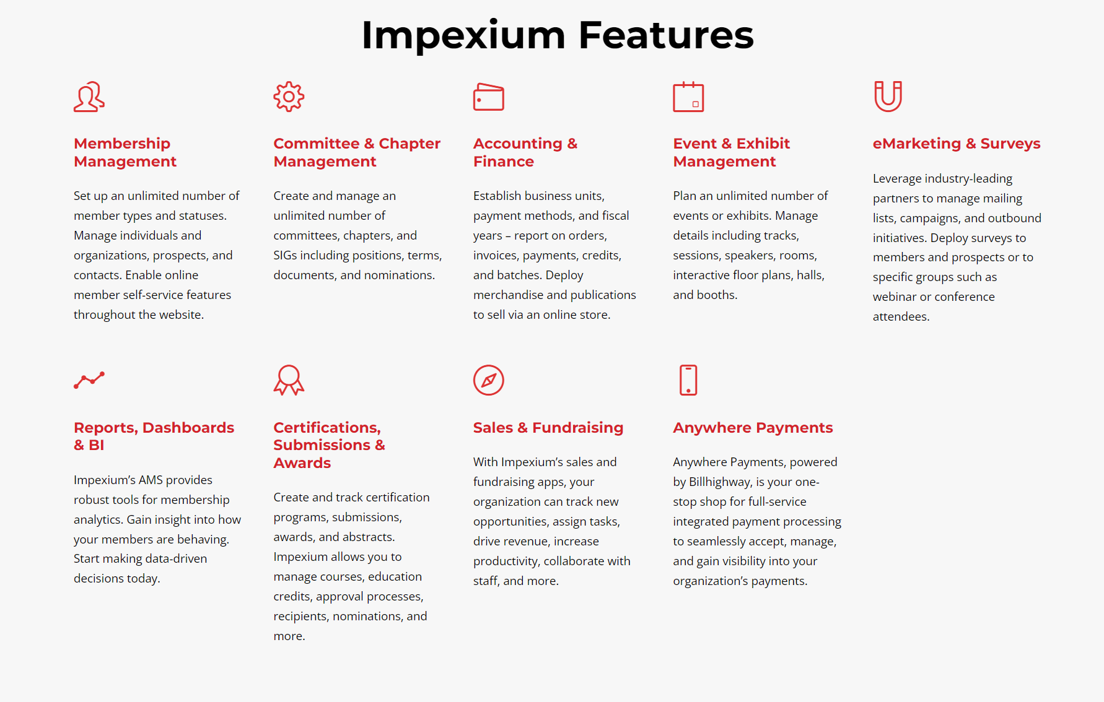

Slide 18
Together we can build MSSNY
MSSNY | CONNECT * ENGAGE * INFLUENCE * LEARN

